Slide 1
Bioinformatics internship
Class one

Slide 2
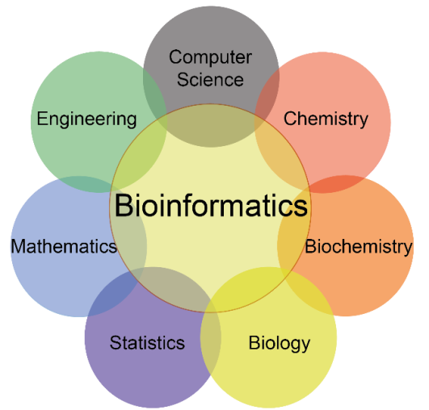
What is bioinformatics
The application of computer programming to analyze complex biological data and answer biological questions efficiently
Create algorithms and implement code
Work typically in research labs in industry jobs and academia

Slide 3
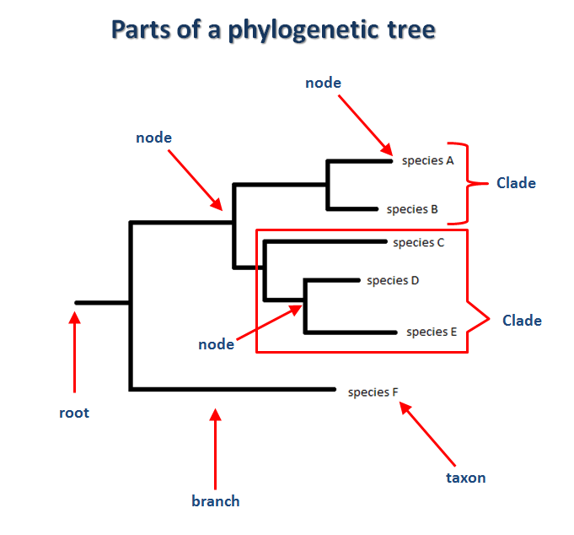
What is phylogenetics
Study of evolutionary relationships between _____

Slide 4
General Session layout
Python fun fact
Rosalind challenges
New topic / review of previous
Map out code in notebooks (work flow charts)
Code / share code
Exit interviews

Slide 5
Assessment

Slide 6
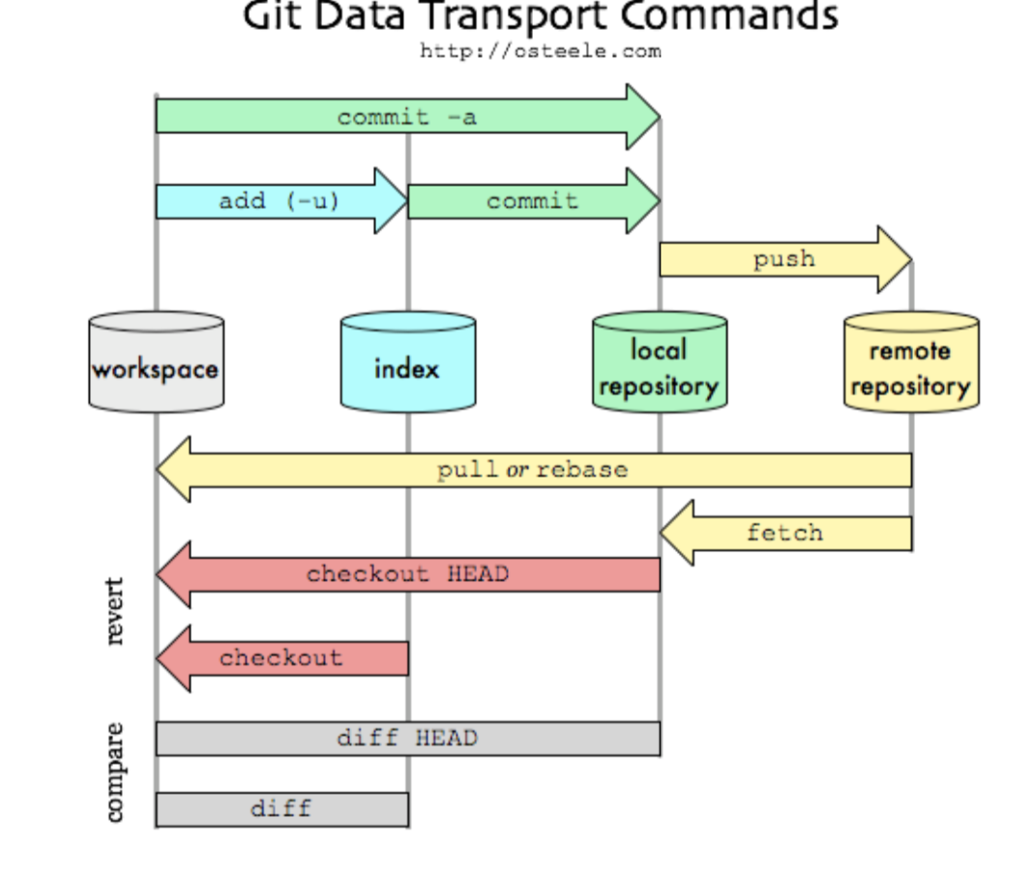

Slide 7
Github
Create a new remote repository (this can be on the same machine):
“git init <PATH> --bare” where PATH is a directory name
Initially copy a remote repo to a local repo:
“git clone <URL> <PATH>” where URL is the URL of the remote repository, and path is the local path to use for the workspace. The local path can be omitted.
Commit all files in the index to the local repo:
“git add”
“git commit”
Pushing the local repo to the remote repo:
“git push”

Slide 8
Why a computer cluster
Setting cosmo up

